Slide 1


From Circular Products to Circular Cities
IL “Introduction to Circular Economy” WS 24-25
Kami Höferl
(Escher, 1961)

Slide 2

Overview
Why Cities?
What are Cities?
What are Circular Cities?
…
(Escher, 1961)
(Escher, 1961)

Slide 3
Why Cities?

Slide 4
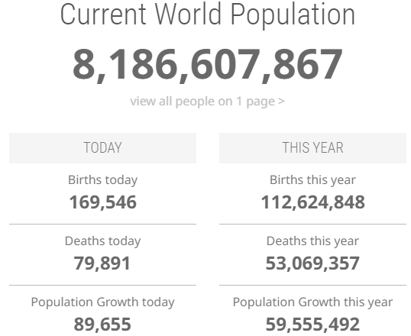
How many are we?

Slide 5
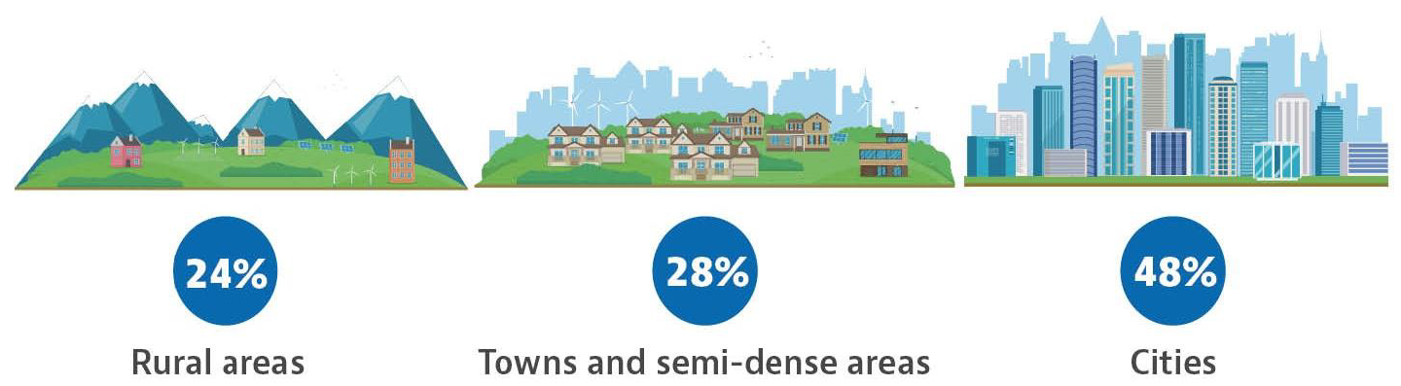
And where are we?
Urbanisation 👉 core phenomenon of global change:
Population in cities (worldwide):
1975: 27%
2000: >40%
2030: >60%

Slide 6
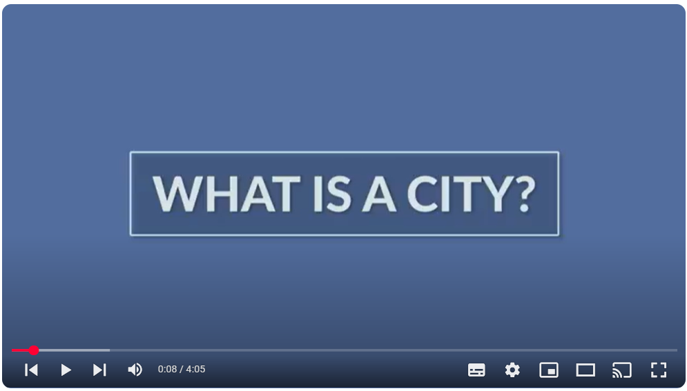
Digression: What is a city?

Slide 7
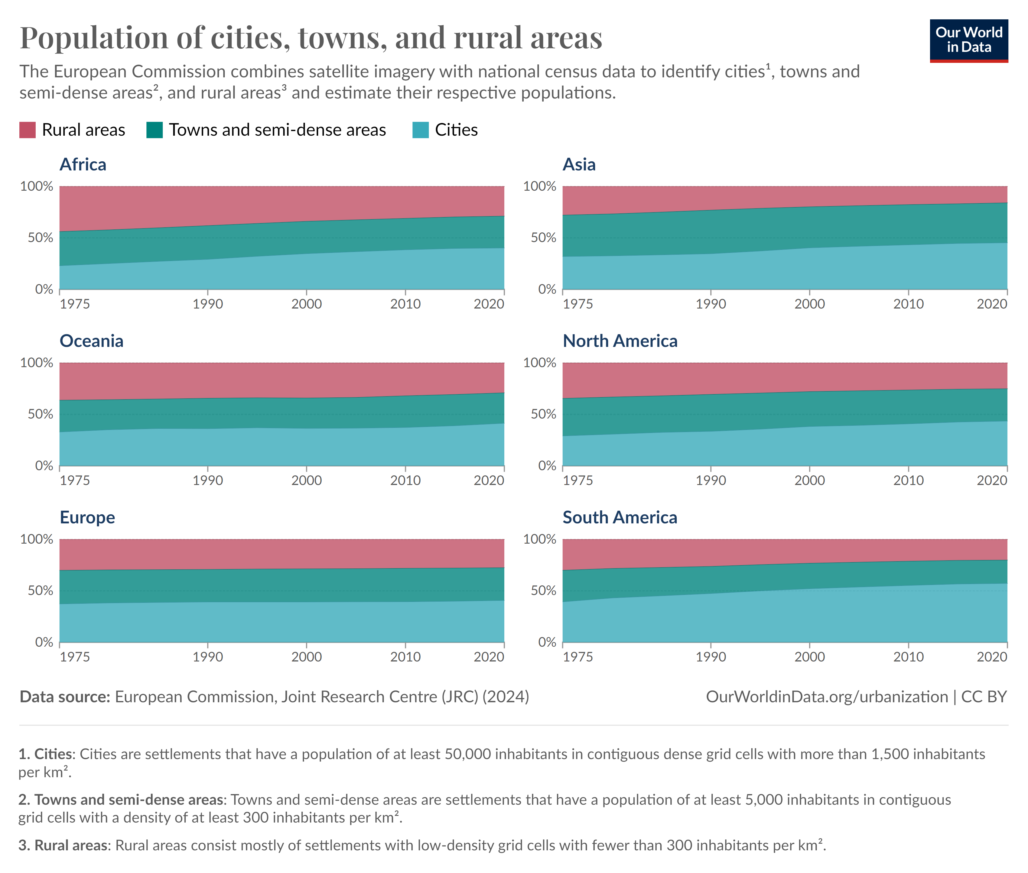
And where are we?

Slide 8
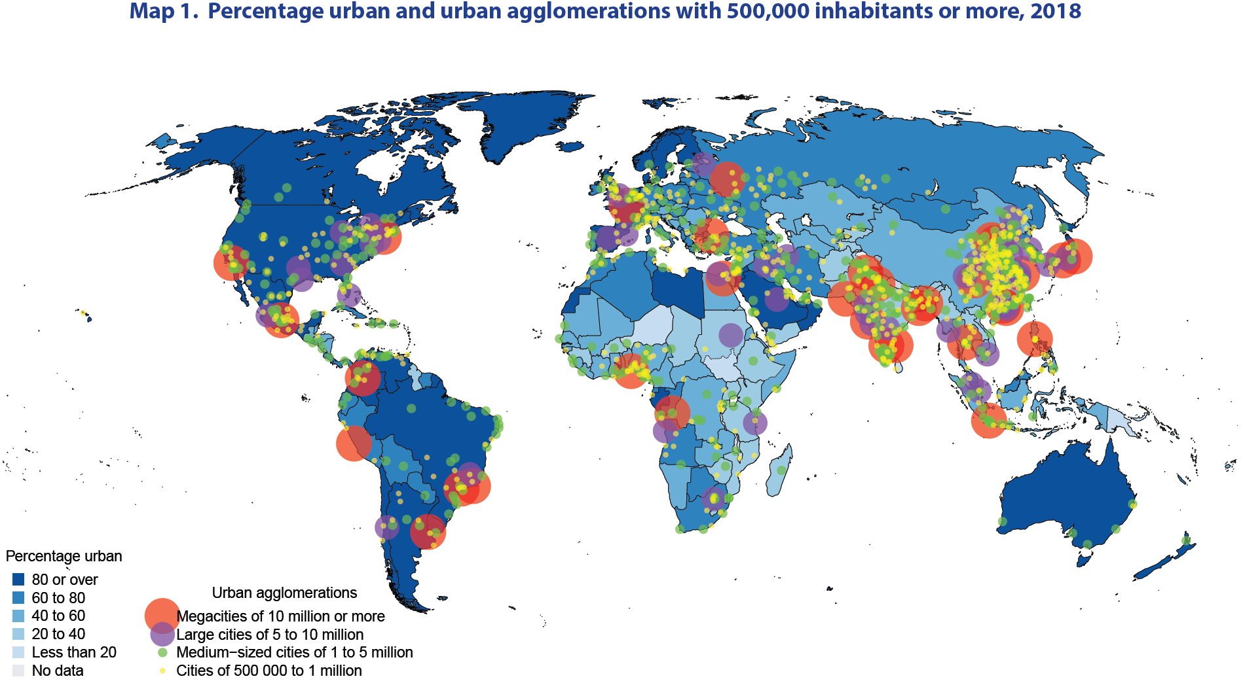
Urban Agglomerations with 500,000+ Inhabitants (2018)

Slide 9
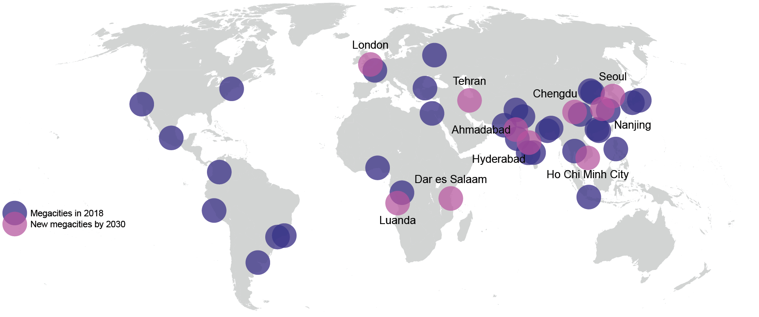
The Mega-Future

Slide 10
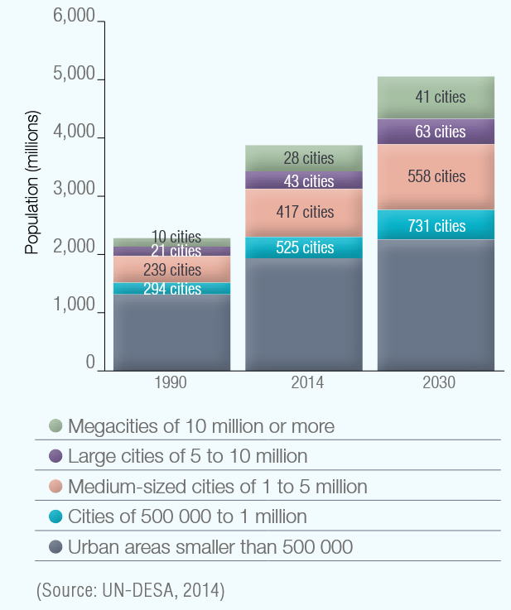
The Mega-Future

Slide 11
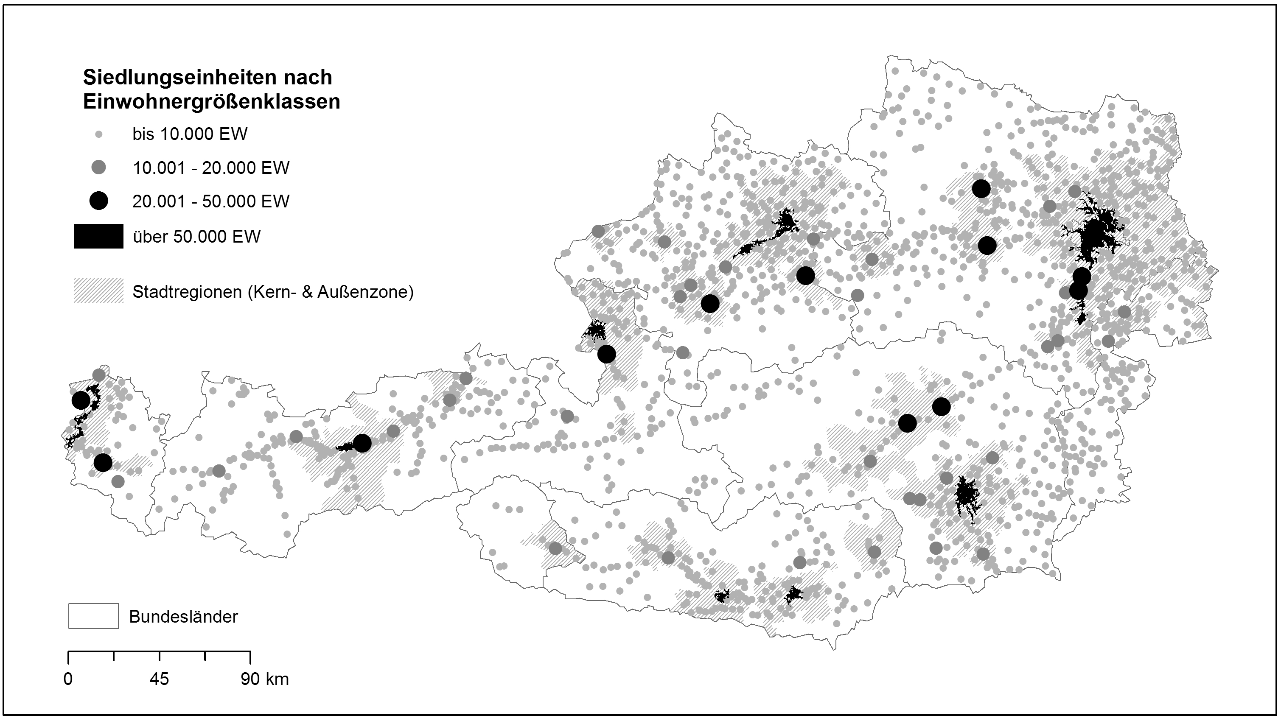
Beware: Cities ≠ Cities
Notes:
+ 3.069 SE (2011) mit 570 Gebäuden & 2.400 EW
* Ca. 80% aller Gebäude
* Ca. 7,3 Mio EW → 87% Bevölkerung

Slide 12
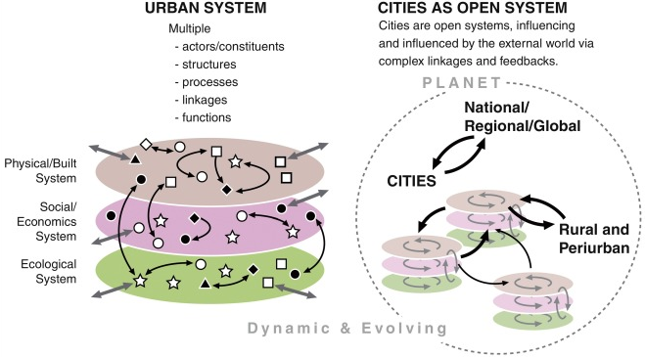
Cities as complex Systems

Slide 13
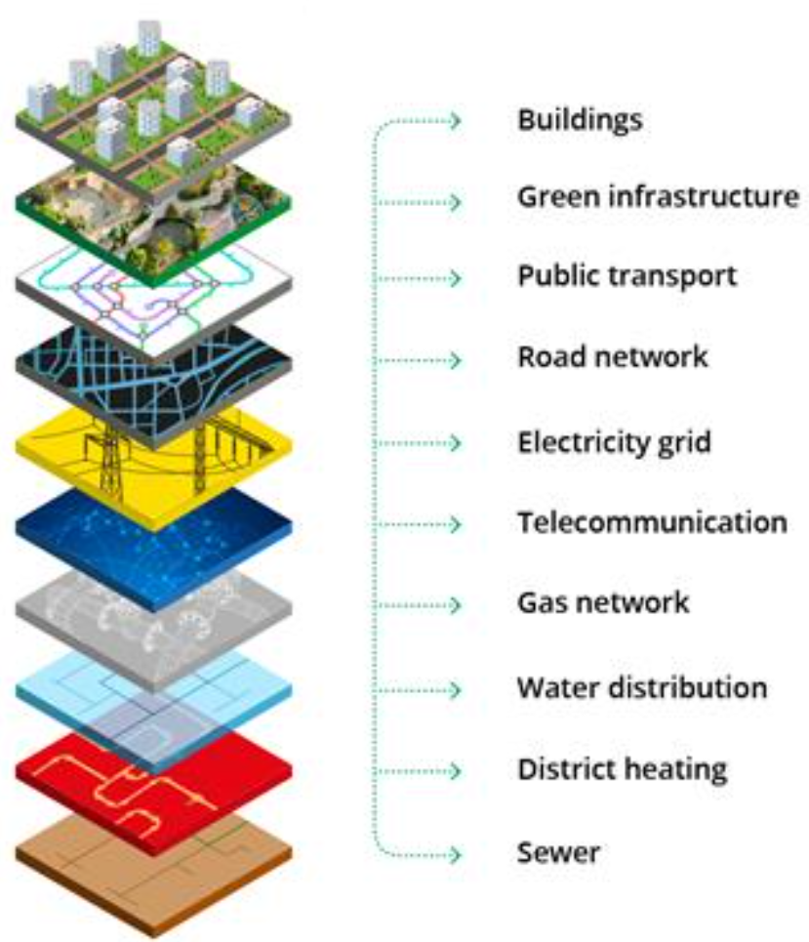
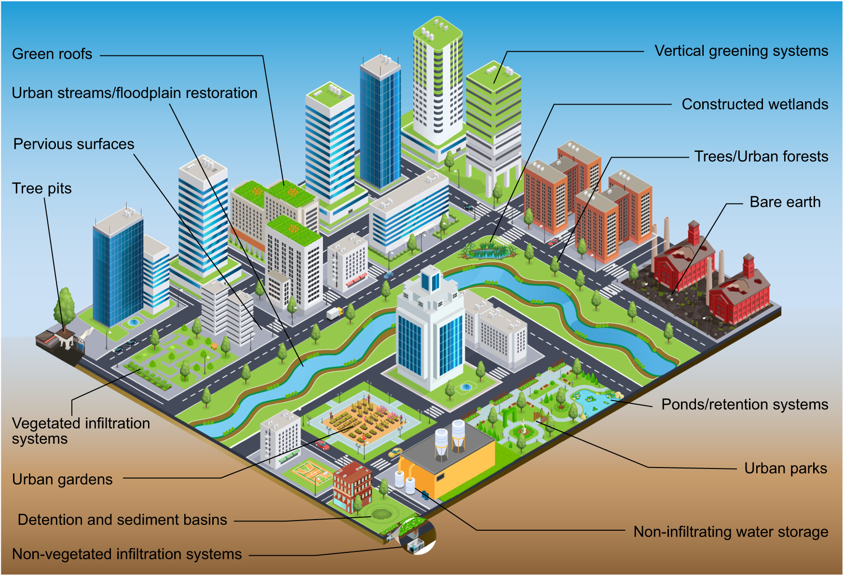
Cities as complex technical and ecological Systems

Slide 14
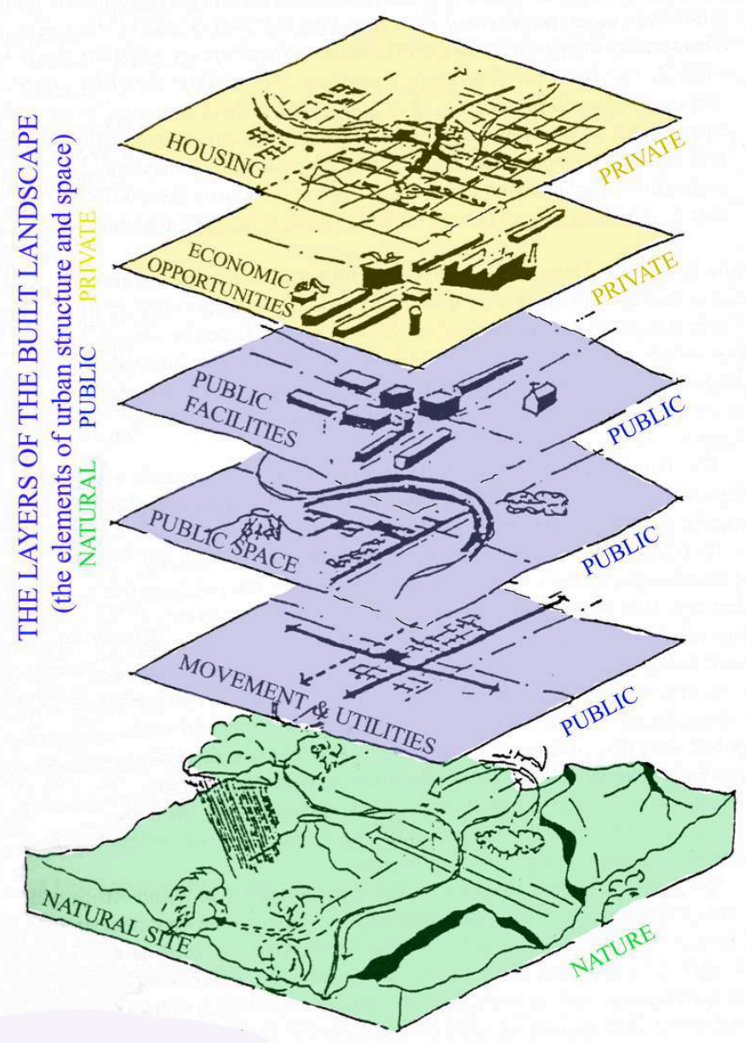
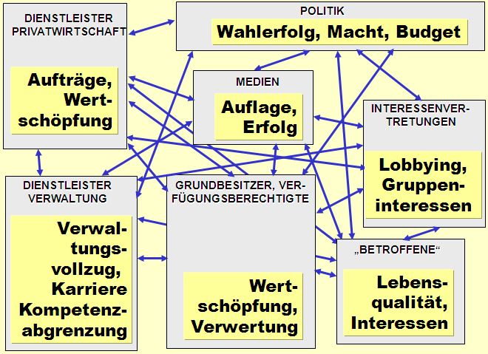
Cities as complex social Systems

Slide 15
Urban resource hunger
Urban population will rise: 55% in 2025 to 68% in 2050
70% to 75% of total natural resource consumption
From 40 million tonnes in 2010 to 90 billion tonnes in 2050
75% of global primary energy use
Greater exposure to environmental stressors e.g. air pollution, noise etc.
Potential for greater resource efficiency due to higher densities
E.g. district heating, urban mining, mobility etc.

Slide 16
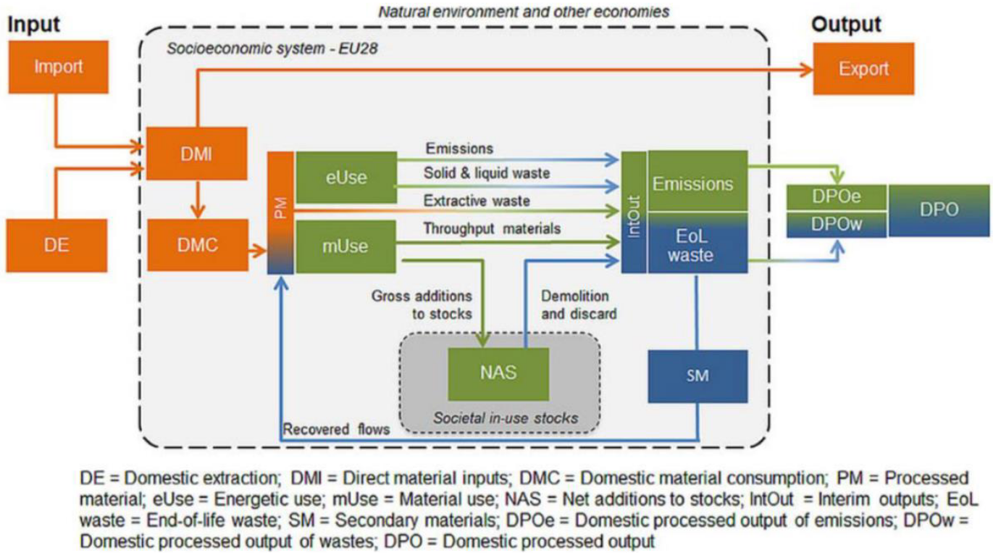
Cities as metabolic Systems

Slide 17
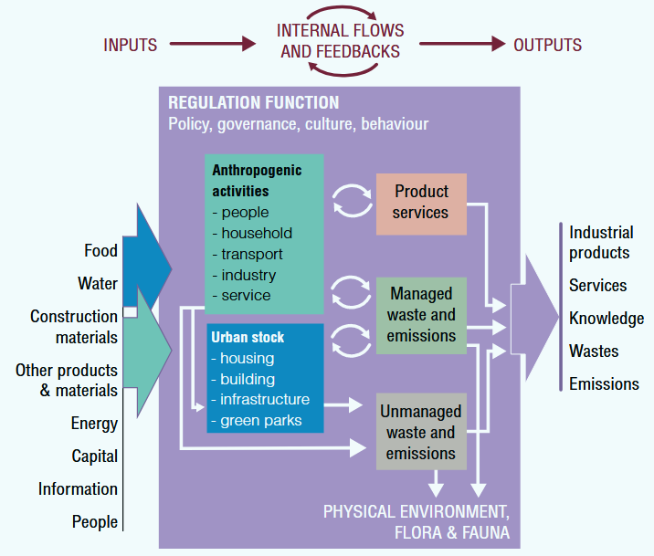
Cities as metabolic Systems

Slide 18
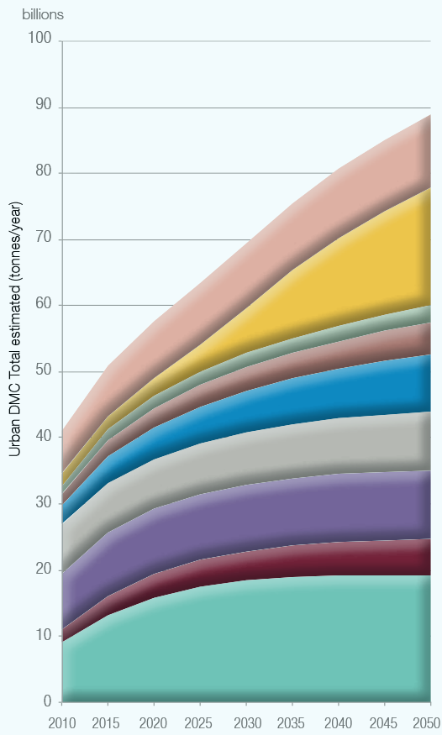
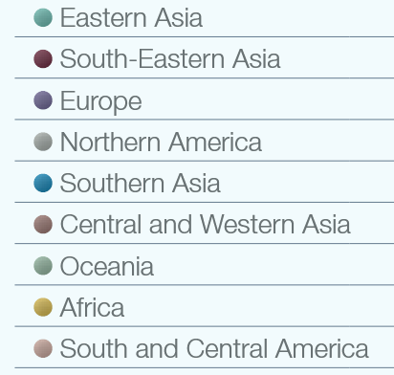
Urban Resource Hunger: Composition global urban DMC

Slide 19
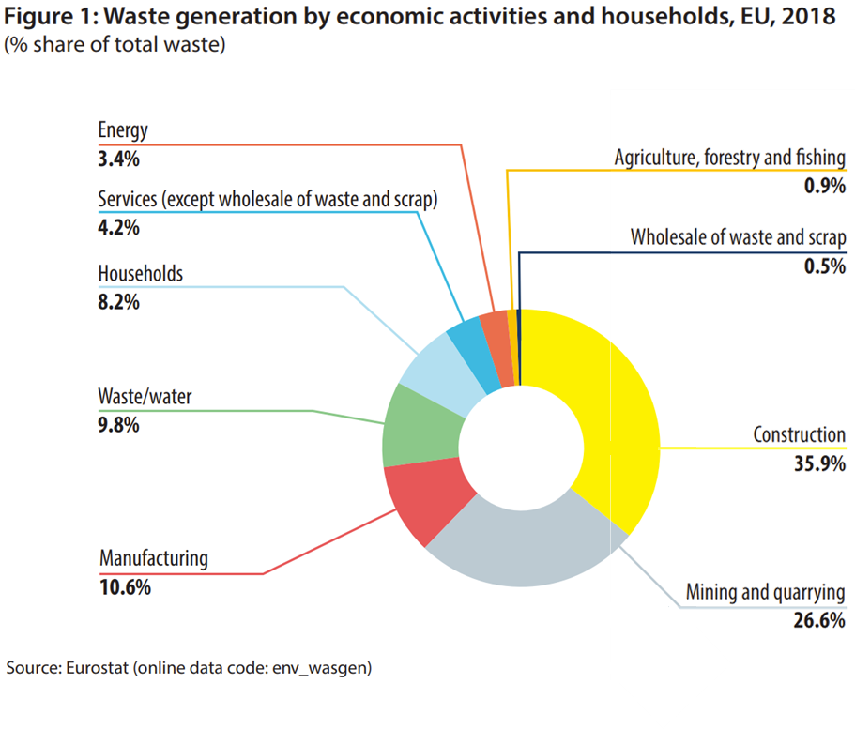
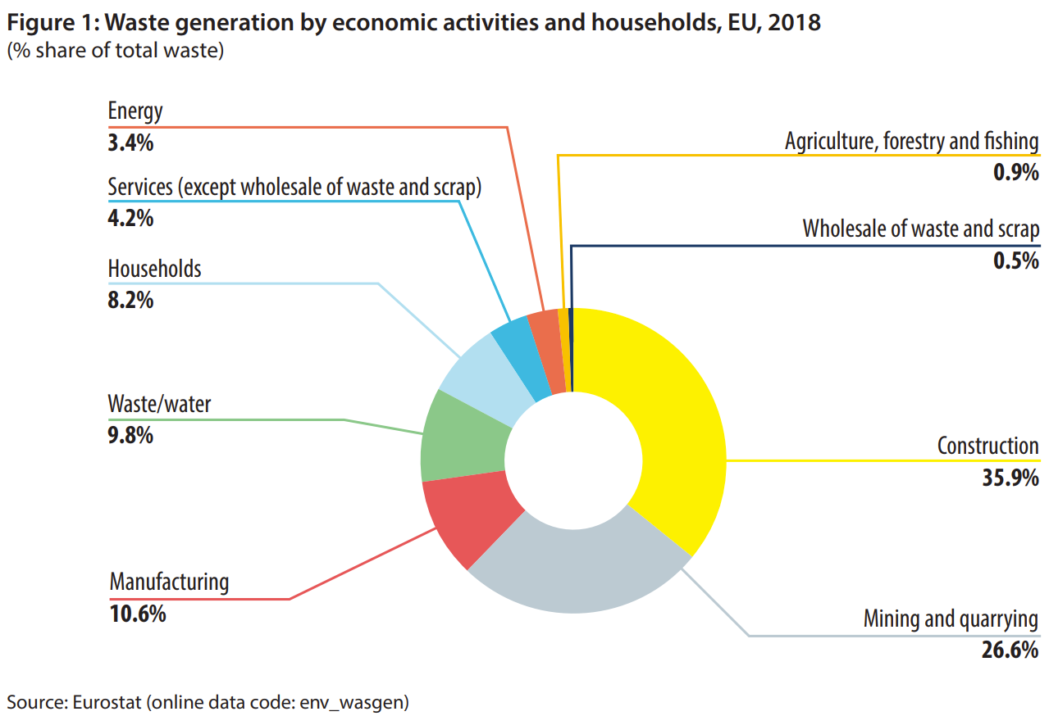

Digression: Urban DMC
Notes:
Quarrying: open pit - S&s & gravel

Slide 20
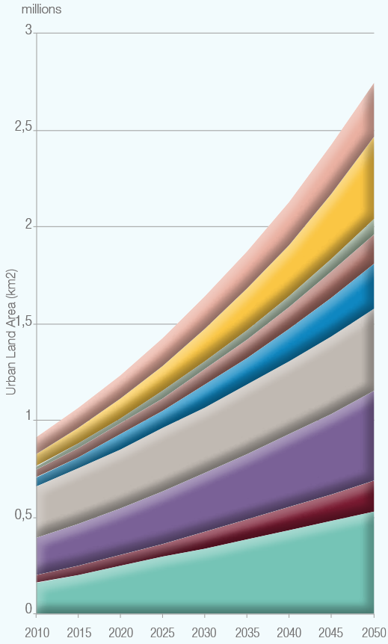
Urban Resource Hunger: Urban land area

Slide 21
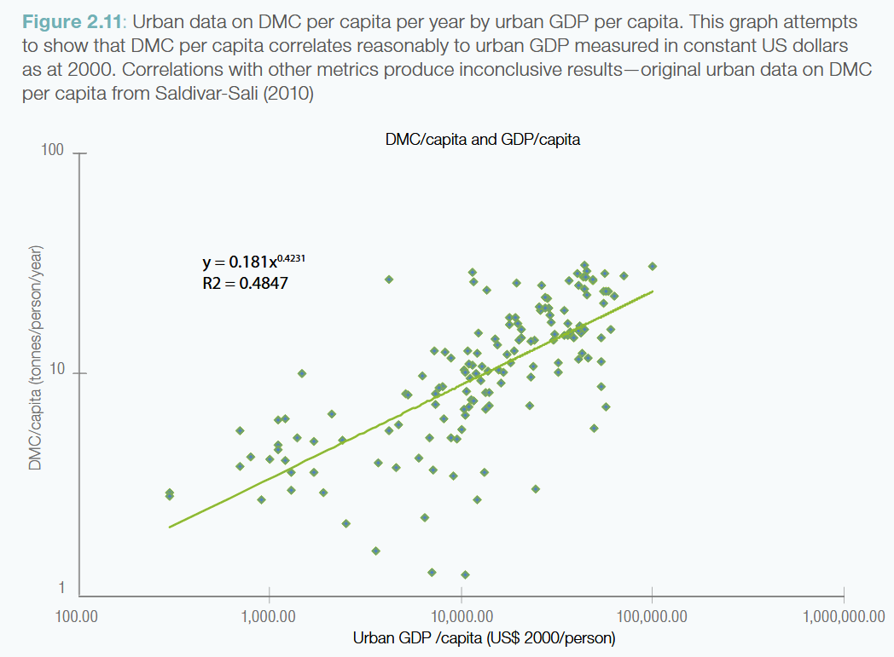
Urban Resource Hunger & Urban Development

Slide 22
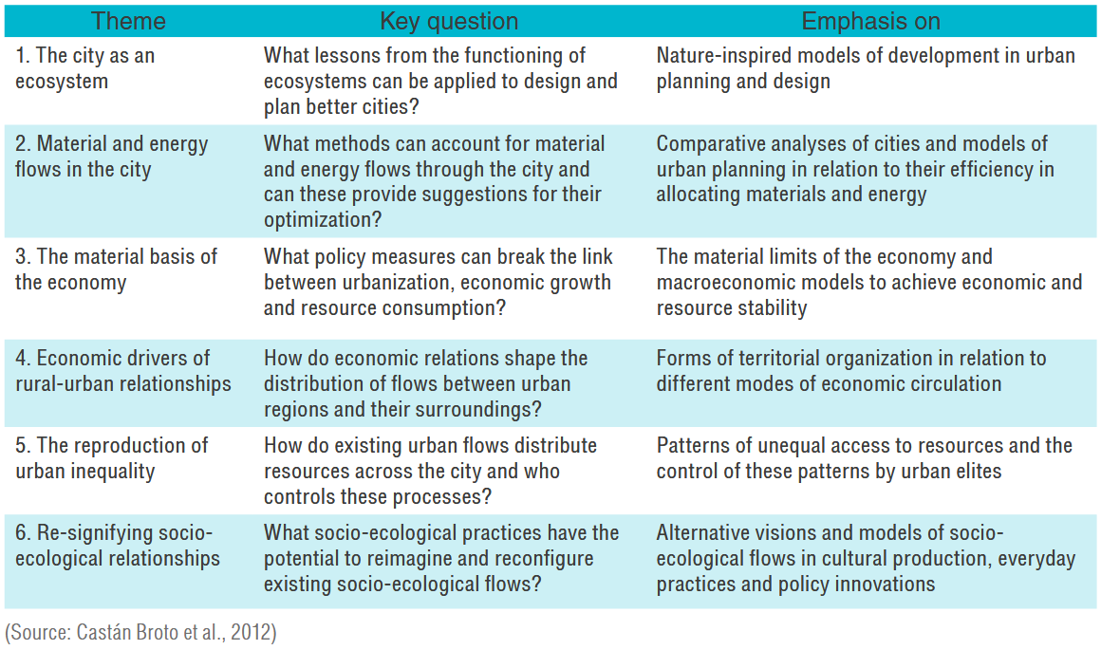
Cities as metabolic Systems: Key Questions

Slide 23
Circularity & Cities

Slide 24
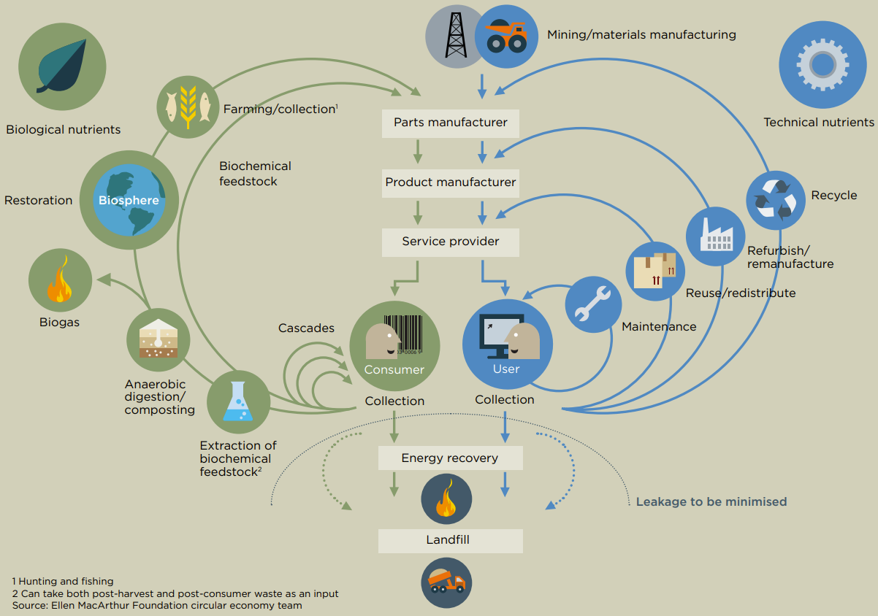

Our starting Point:
Notes:
Linear: Take – make – waste
80% environmental impact from insufficient design (EC, 2020:3)
Walter Stahel: 1982 „closed loop economy“
2013: Ellen MacArthur Foundation Vol. 1
3R: 2008 Circular Economy Promotion Law of the People’s Republic of China
MacArthur:
Eliminate waste and pollution
Circulate products and materials (at their highest value)
Regenerate Nature

Slide 25
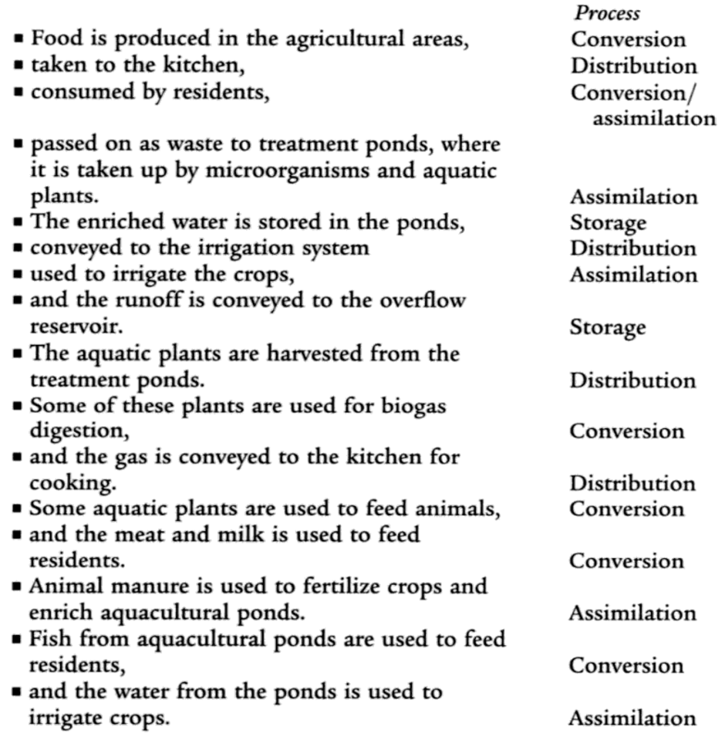
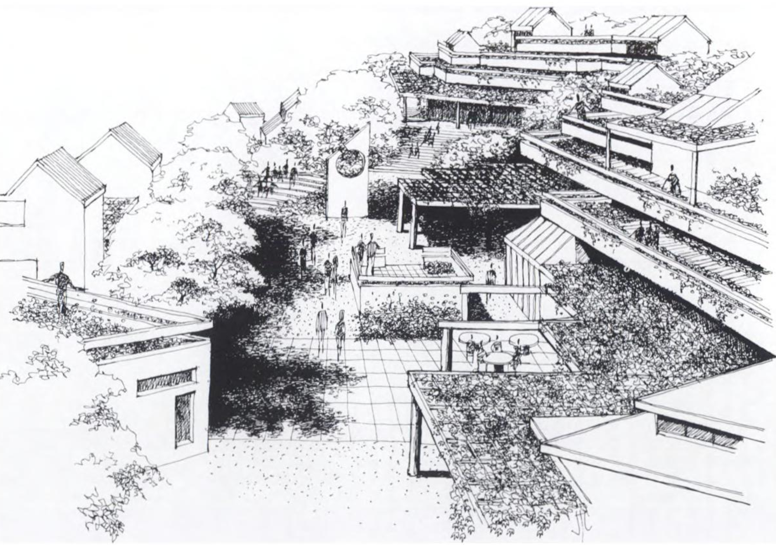
Regenerative Design & Cities: Lyle’s Center
“The unifying concept of the Center is the human ecosystem”
Notes:
Design team:
16 acres of land
20 Students
2 visiting scholars
1 resident advisor

Slide 26
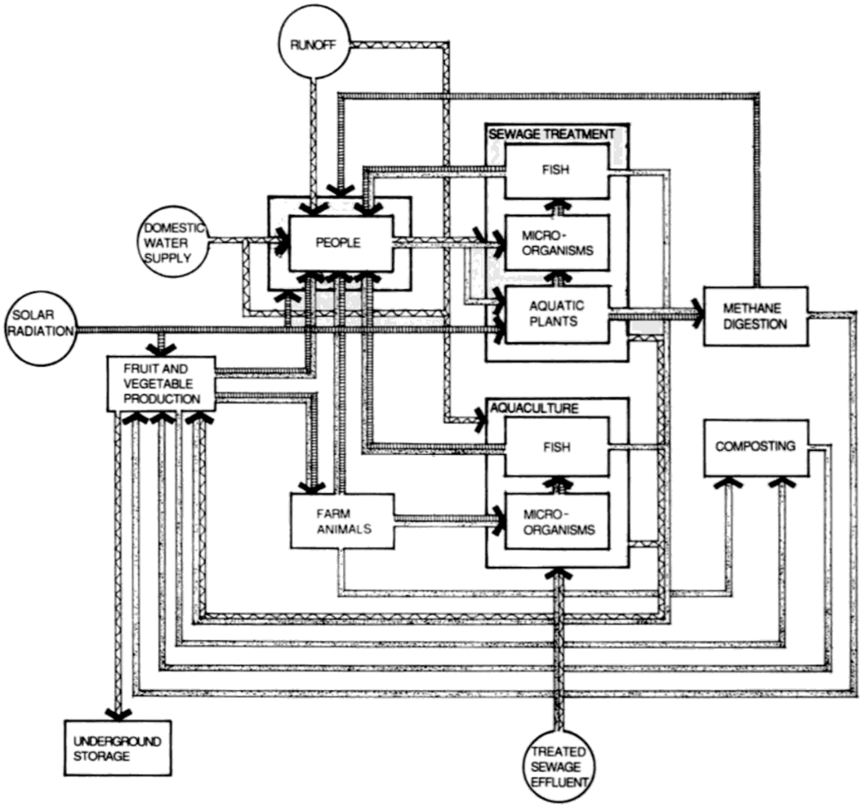

Regenerative Design & Cities: Lyle’s Center
Notes:
Design team:
16 acres of land
20 Students
2 visiting scholars
1 resident advisor

Slide 27
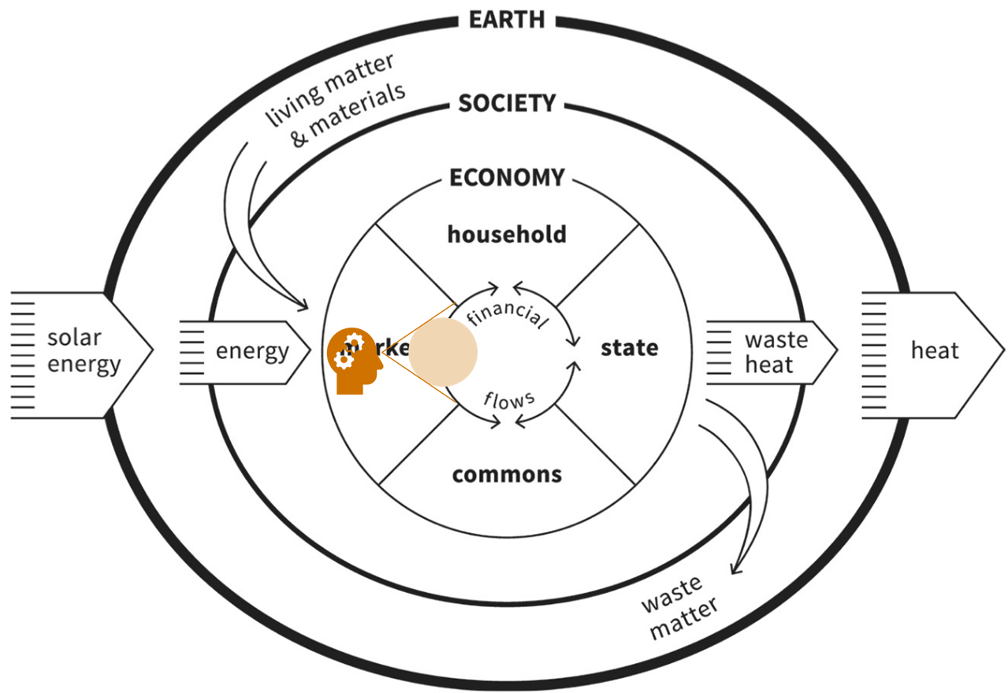


Cities as Arenas in Raworth’s “Doughnut Economy”

Slide 28
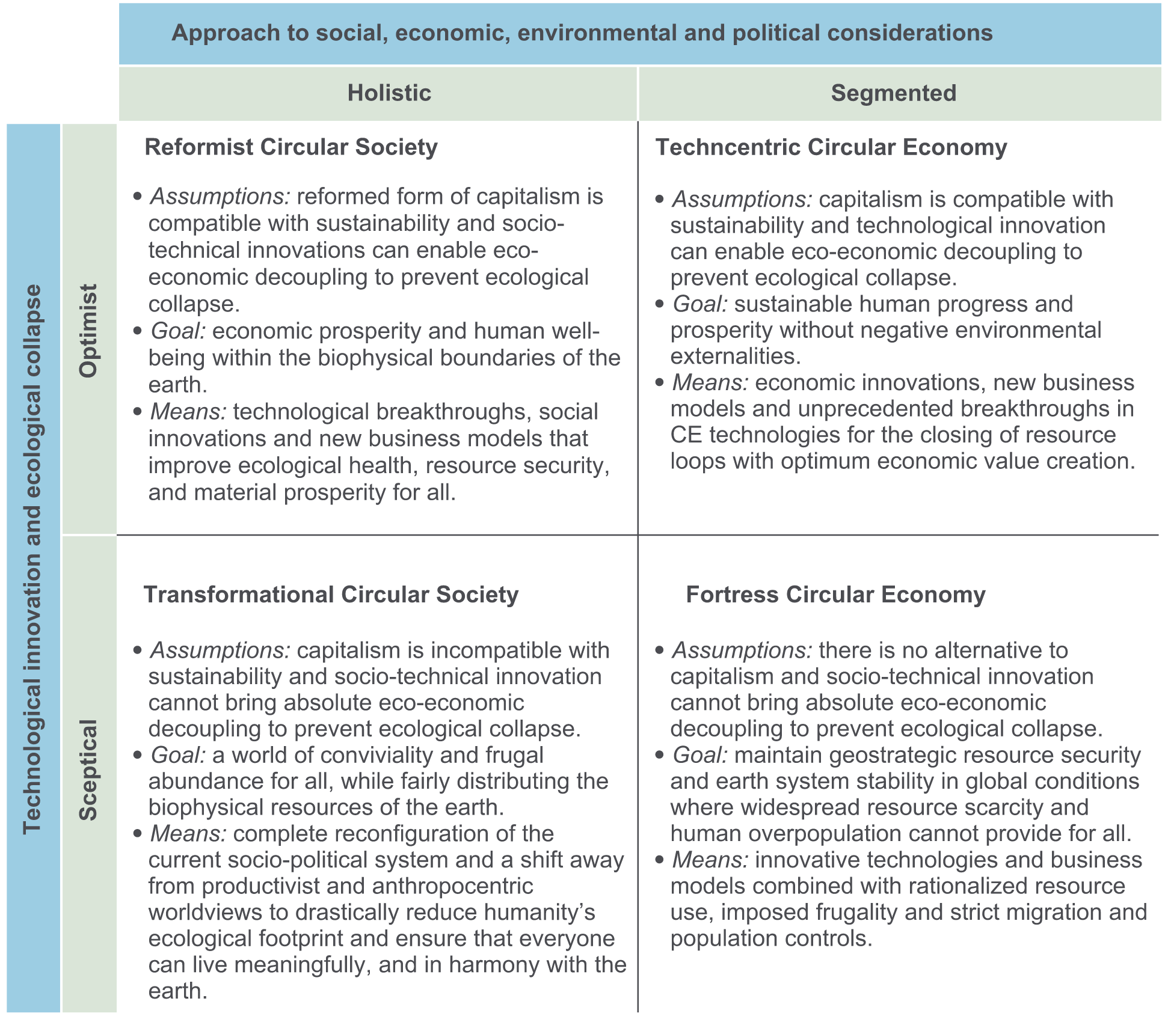
Cities as holistic Arenas (again) in Friant et al’s (2020) Typology

Slide 29
Circularity for Cities – some Benefits:
Resource Efficiency: Cities consume 75% of natural resources 👉 reduces resource depletion
Waste Reduction: Minimise waste generation and landfill use through recycling, reuse & recovery.
Climate Action: lower greenhouse gas emissions by optimising energy & resource use
Urban Resilience: Enhances ability to adapt to environmental, social, and economic challenges
Economic Benefits: new business opportunities in repair, recycling, & remanufacturing
Biodiversity Protection: Reduces land use, pollution, & habitat destruction.
Improved Quality of Life: Promote cleaner, greener, and healthier urban environments

Slide 30
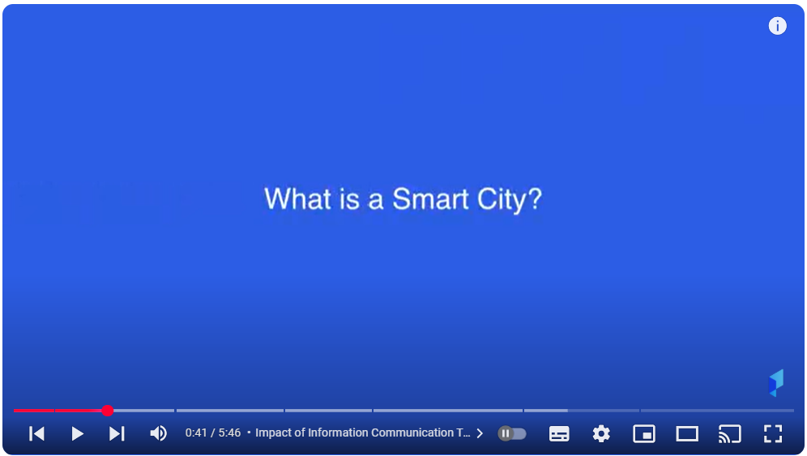
A parallel Development since the beginning 2000s: Smart Cities
Notes:
# Holistic development concepts - making cities more efficient, technologically advanced, greener and more socially inclusive. → Focus on technical, economic and social innovations

Slide 31
Smart Cities: Some Defintions
“the effective integration of physical, digital and human systems in the built environment to deliver a sustainable, prosperous and inclusive future for its citizens” (BSI 2014)
“a place where traditional networks and services are made more efficient with the use of digital solutions for the benefit of its inhabitants and business.” (EU, n.d.)
“an urban area that uses digital technology to collect data and to operate/provide services” (Wikipedia, 2024)

Slide 32
Advanced Design of …
Innovation economy | Urban infrastructure | Governance
Innovation in industries, clusters, districts of a city | Transport | Administration services to the citizen
Knowledge workforce: Education and employment | Energy / Utilities | Participatory and direct democracy
Creation of knowledge-intensive companies | Protection of the environment / Safety | Services to the citizen: Quality of life

Slide 33
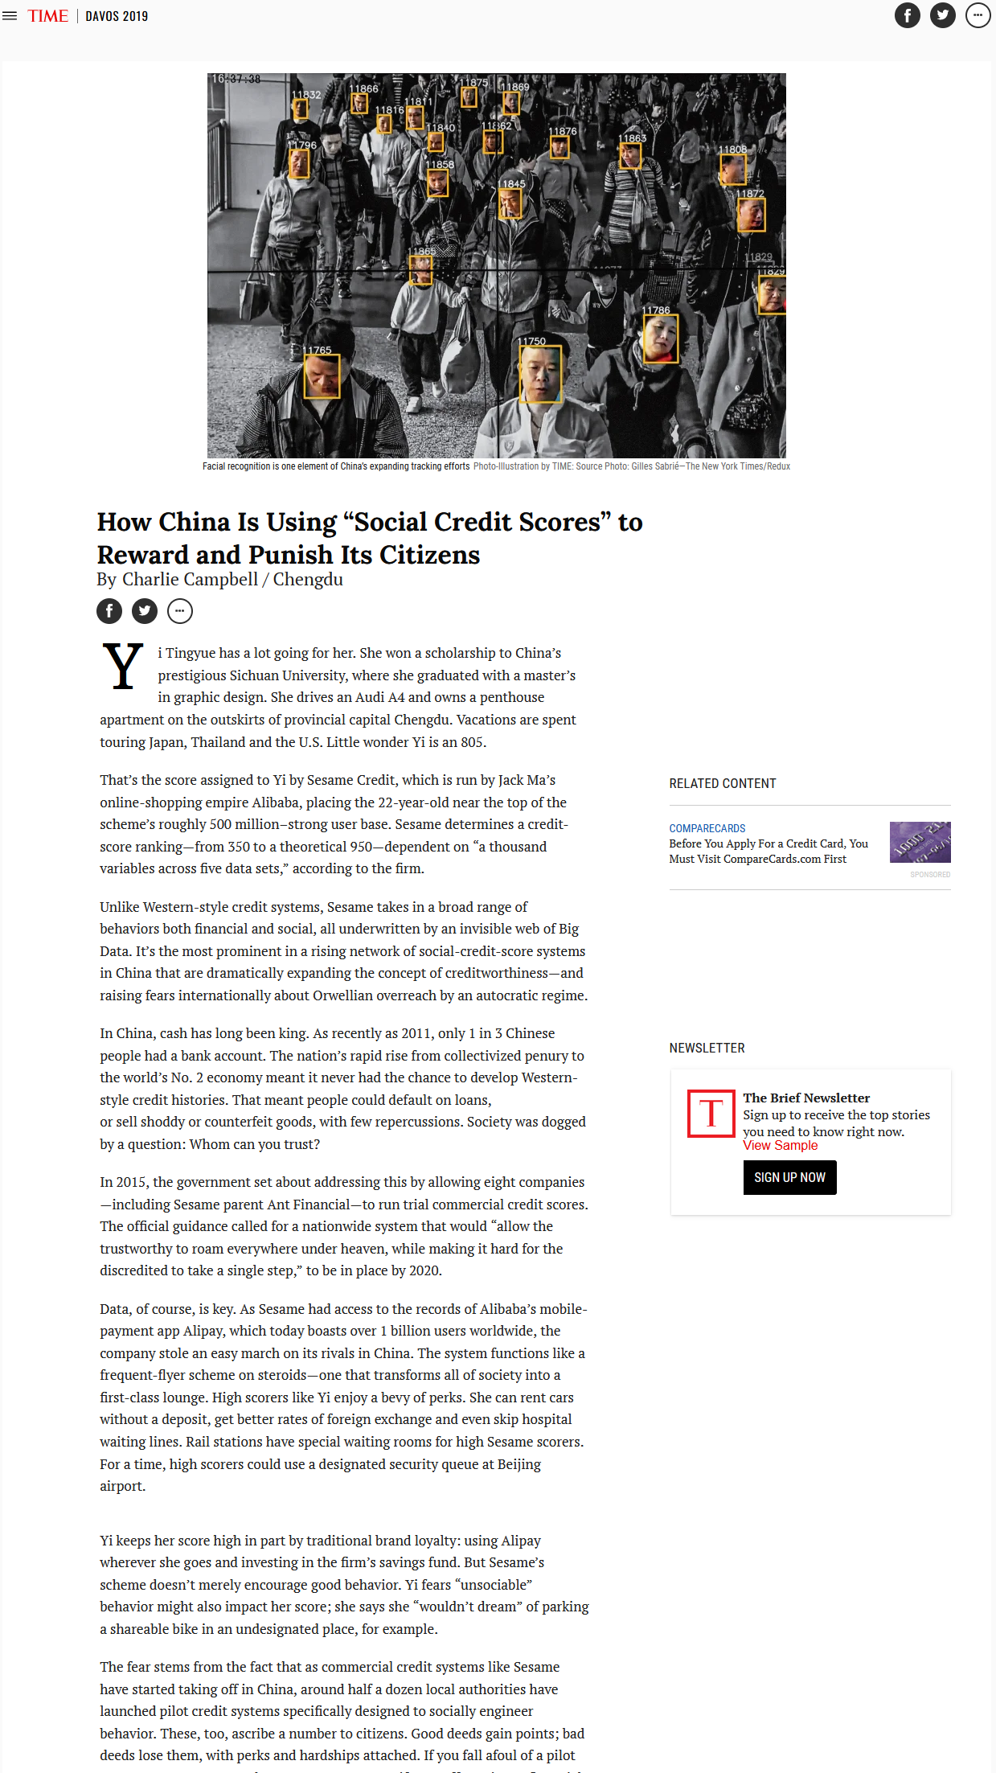
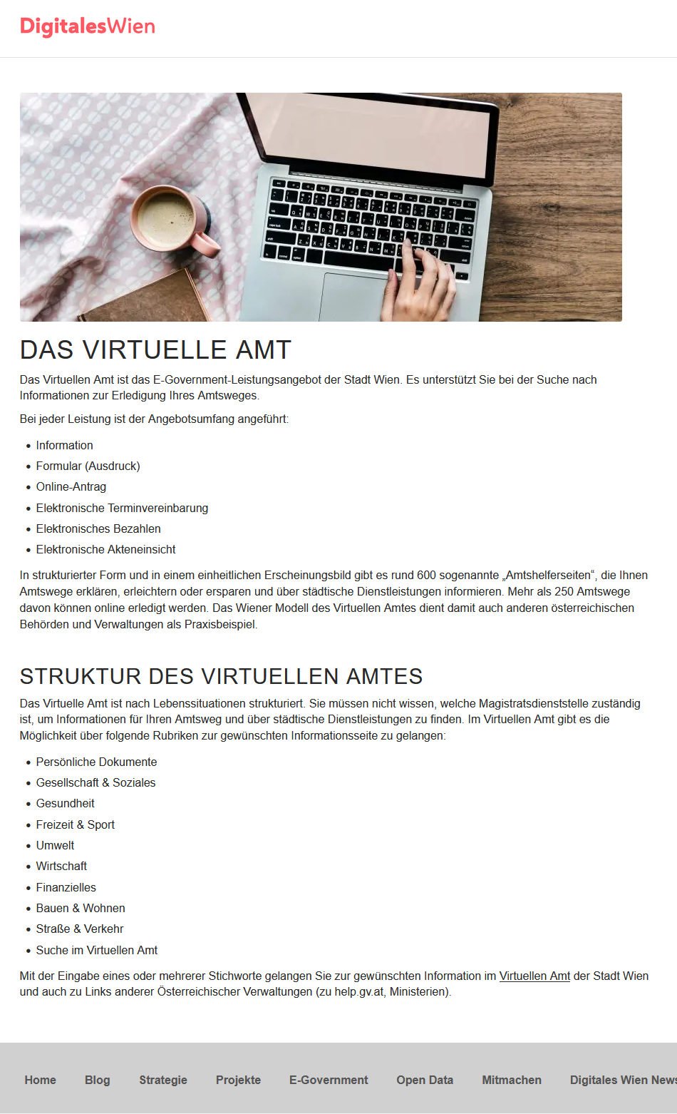
Ups and Downs of this Advanced Design

Slide 34
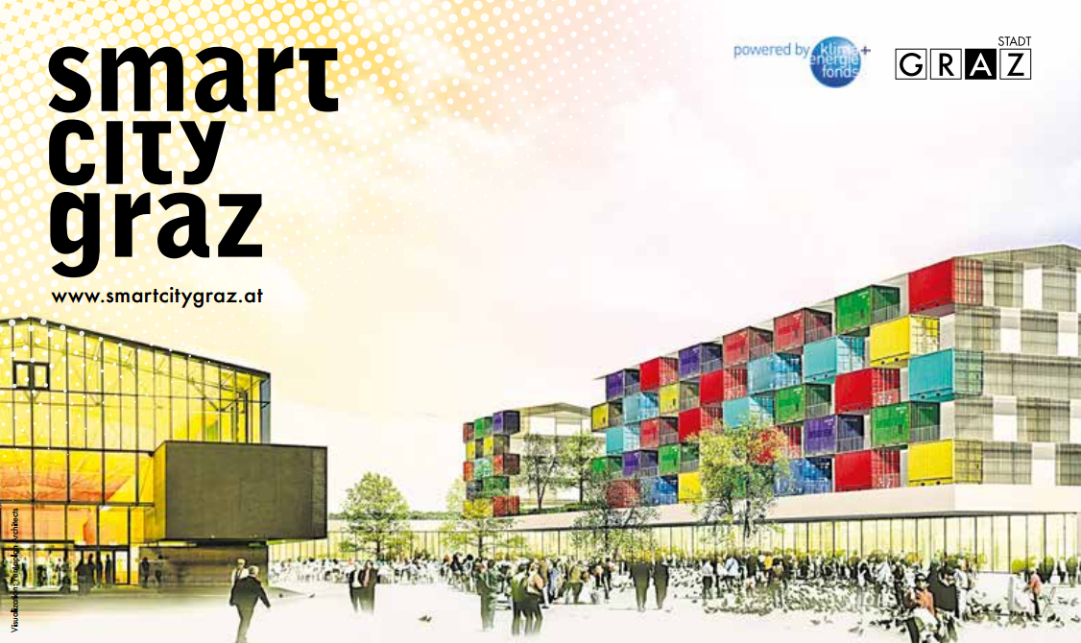
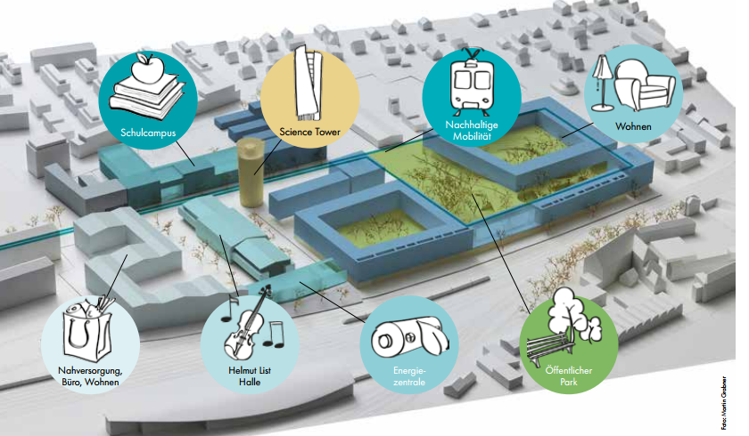
Smart City Approaches in Austria
Notes:
Smart City Graz 2050: Wagner Biro Areal – hinter Bahnhof
Verdichtung von innerstädtischen, infrastrukturell bestens ausgestatteten Lagen. Hier sollen energieeffiziente, ressourcenschonende und emissionsarme Stadtquartiere mit höchster Lebensqualität realisiert werden.
# BSP: Begleitrollmaterial Seestadt Aspern Wien → Lastenfahrräder, E-Tankstellen für Fahrräder & Autos etc.

Slide 35
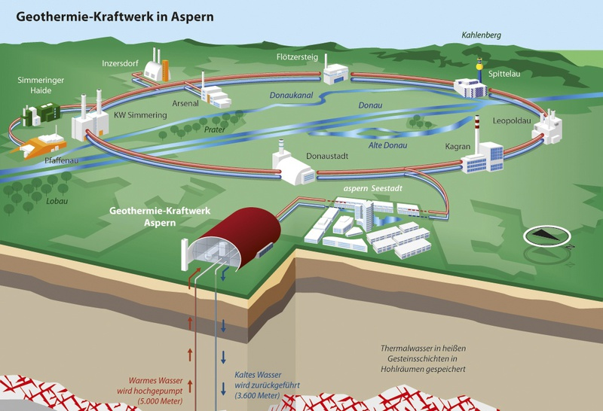
Smart City Approaches in Austria
Notes:
Smart City Graz 2050: Wagner Biro Areal – hinter Bahnhof
Verdichtung von innerstädtischen, infrastrukturell bestens ausgestatteten Lagen. Hier sollen energieeffiziente, ressourcenschonende und emissionsarme Stadtquartiere mit höchster Lebensqualität realisiert werden.
# BSP: Begleitrollmaterial Seestadt Aspern Wien → Lastenfahrräder, E-Tankstellen für Fahrräder & Autos etc.

Slide 36
What is a Circular City?

Slide 37
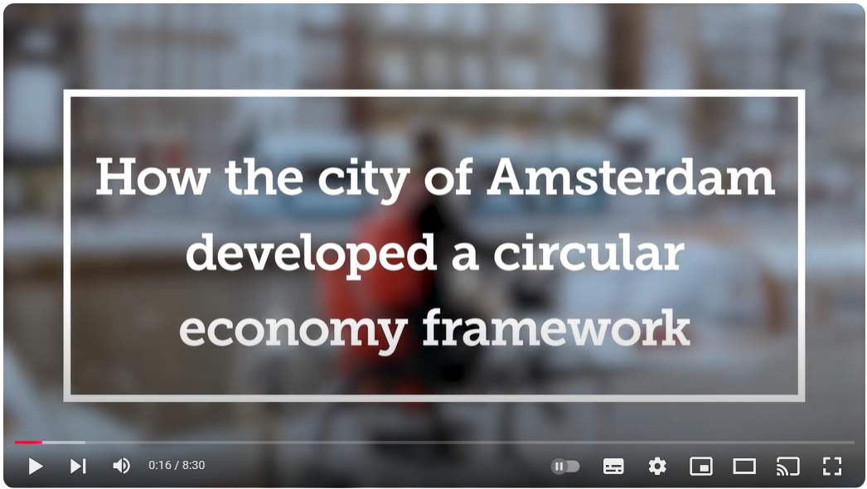
Friant et al.‘s (2020) Reformist Circular Society

Slide 38
Circular Cities: Some Definitions (again 😉) …
“A circular city is based on closing, slowing and narrowing the resource loops as far as possible after the potential for conservation, efficiency improvements, resource sharing, servitization and virtualization has been exhausted, with remaining needs for fresh material and energy being covered as far as possible based on local production using renewable natural resources” (Paiho et al., 2020)

Slide 39
A Working Definition from Vangelsten et al. (2020):
A circular city is one in which
1. The local government, civil society, businesses, the research community and other local stakeholders collaborate to promote the transition from a linear to a circular economy. This means in practice:
2. fostering business models and economic behavioural patterns that maintain the value and utility of products, components, materials and nutrients for as long as sensible, in order to
3. close material loops and minimize as much as possible harmful resource use and waste generation locally, and thereby
4. improve human well-being, minimize net environmental impacts, protect and enhance biodiversity, and promote social inclusion, both within the city and globally, in line with the sustainable development goals.

Slide 40
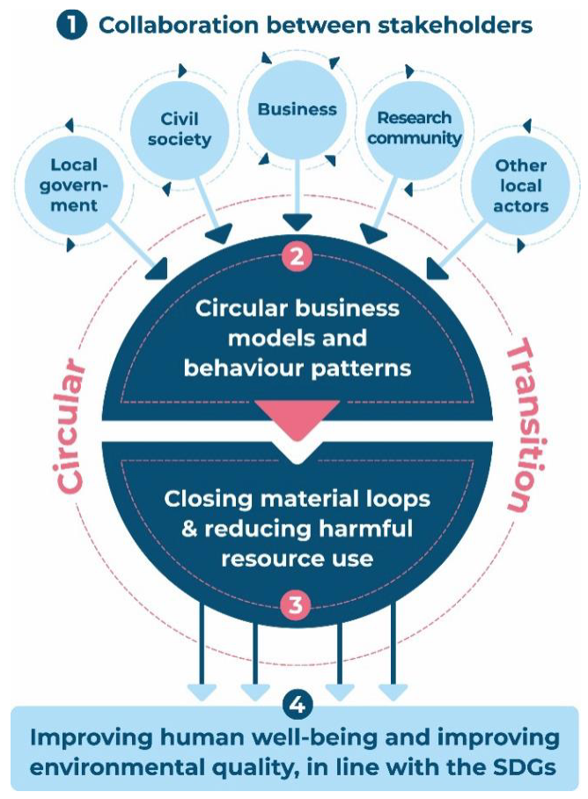
A Working Definition from Vangelsten et al. (2020):

Slide 41
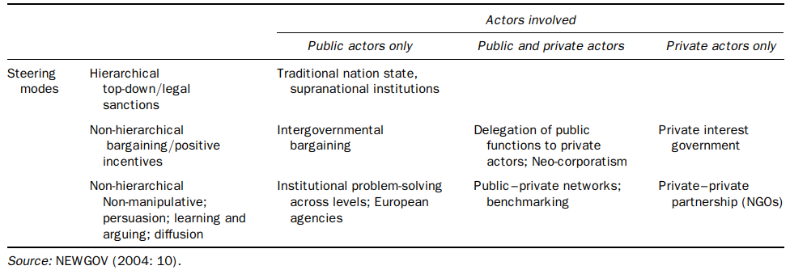
Digression: Urban Governance
👉 frameworks, processes, and actions through which public institutions, authorities, and stakeholders make decisions, implement policies, and manage resources to serve the public interest and achieve societal goals

Slide 42
CE & Urban Governance
“Cities are among the most powerful entities that can impact development favorably if they become circular:
The local government can encourage the reuse of building materials from its own construction, renovations, and demolition projects. As a result, the market for recycled building materials is stimulated.
Grants, incentives, and tax exemptions can be used by local governments to encourage the development of new technology.
Cooperation with other advanced cities to facilitate circular economy implementation. Supporting bottom–up efforts (idea competitions, startup funding).” (Bîrgovan et al., 2022)
Notes:
These are the primary causes of climate change, accounting for up to 76% of all carbon emissions. Despite occupying fewer than 2% of the Earth’s area, they account for 75% of world natural resource usage and 50% of global garbage generation.

Slide 43
CE & Urban Governance
“Cities are among the most powerful entities that can impact development favorably if they become circular:
The local government can encourage the reuse of building materials from its own construction, renovations, and demolition projects. As a result, the market for recycled building materials is stimulated.
Grants, incentives, and tax exemptions can be used by local governments to encourage the development of new technology.
Cooperation with other advanced cities to facilitate circular economy implementation. Supporting bottom–up efforts (idea competitions, startup funding).” (Bîrgovan et al., 2022)
Notes:
These are the primary causes of climate change, accounting for up to 76% of all carbon emissions. Despite occupying fewer than 2% of the Earth’s area, they account for 75% of world natural resource usage and 50% of global garbage generation.

Slide 44
Can Circular Cities be done?

Slide 45
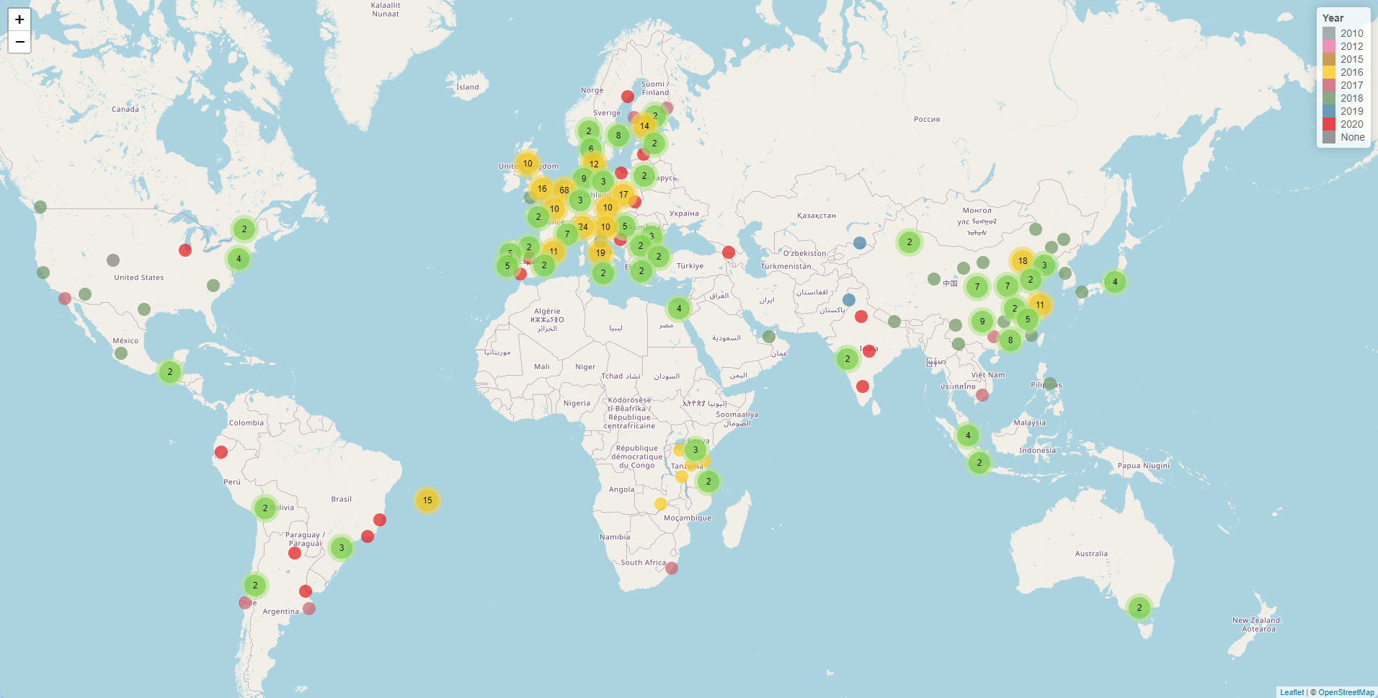
Where can we find Circular Cities?

Slide 46
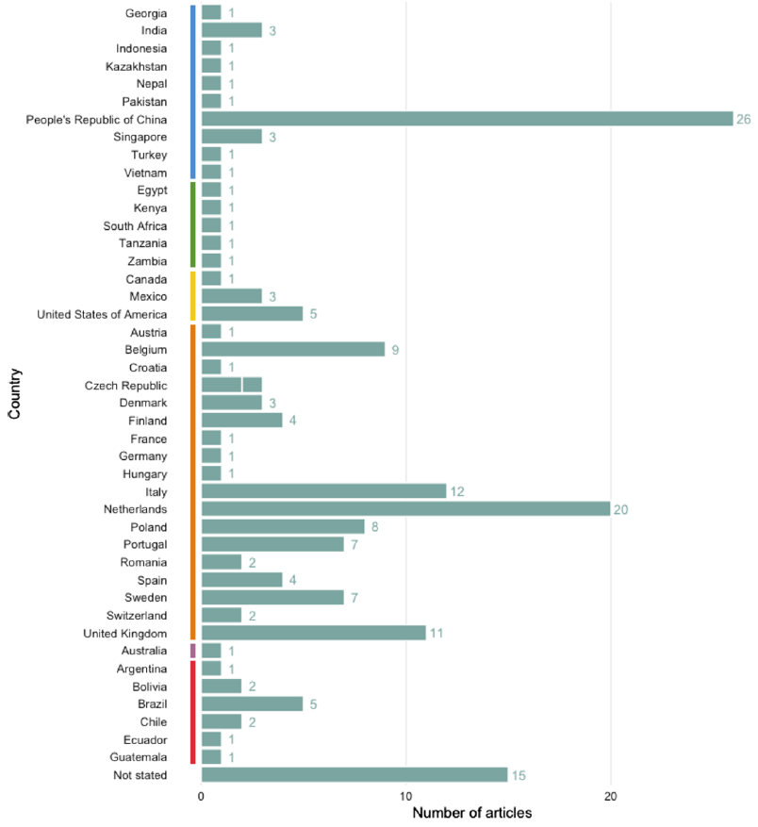
Where can we find Circular Cities?

Slide 47
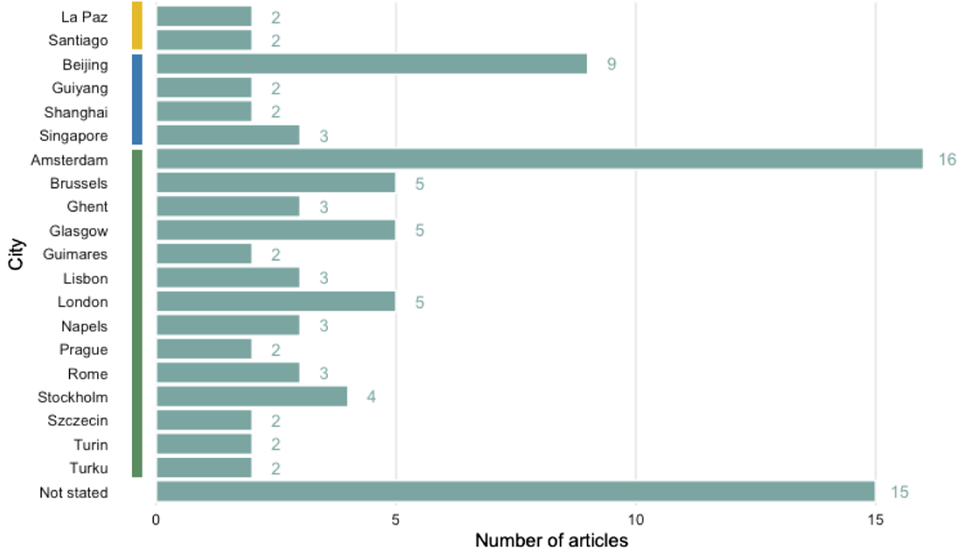
Where can we find Circular Cities?

Slide 48
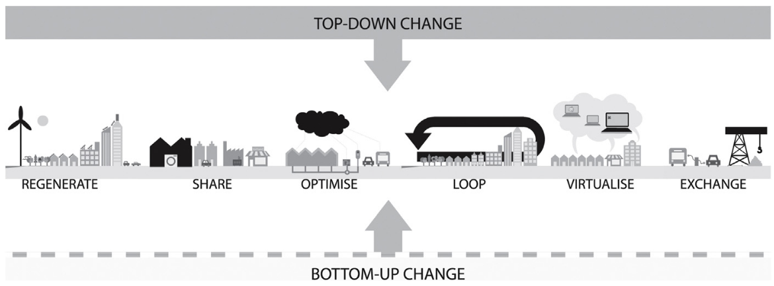
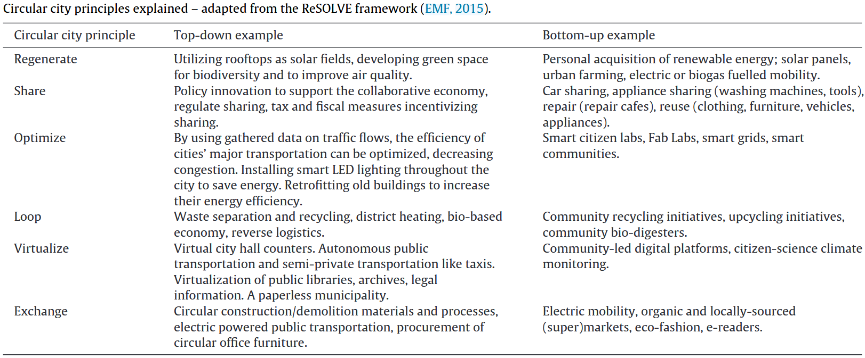
And what are they doing?

Slide 49
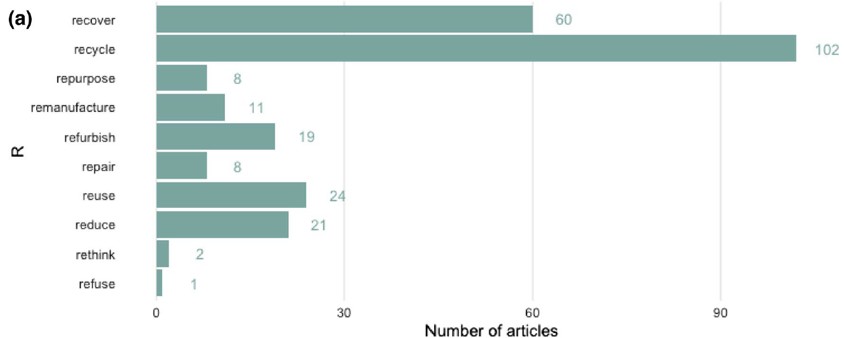
And what are they doing?

Slide 50
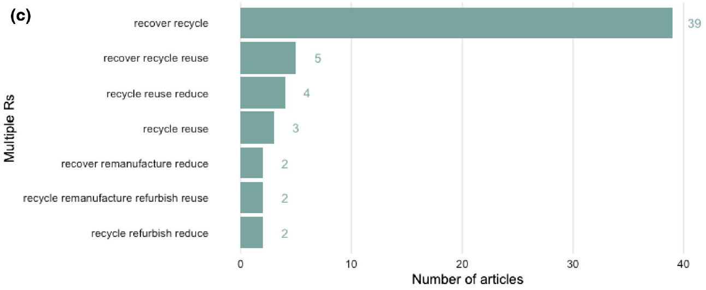
And what are they doing?

Slide 51
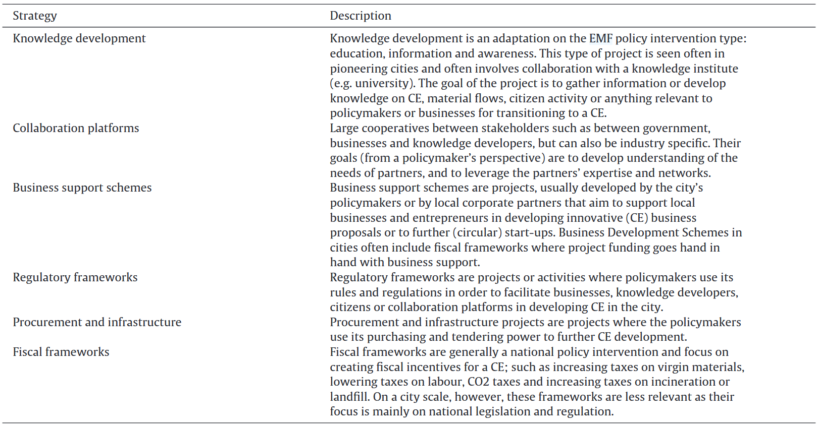
And what are they doing?

Slide 52
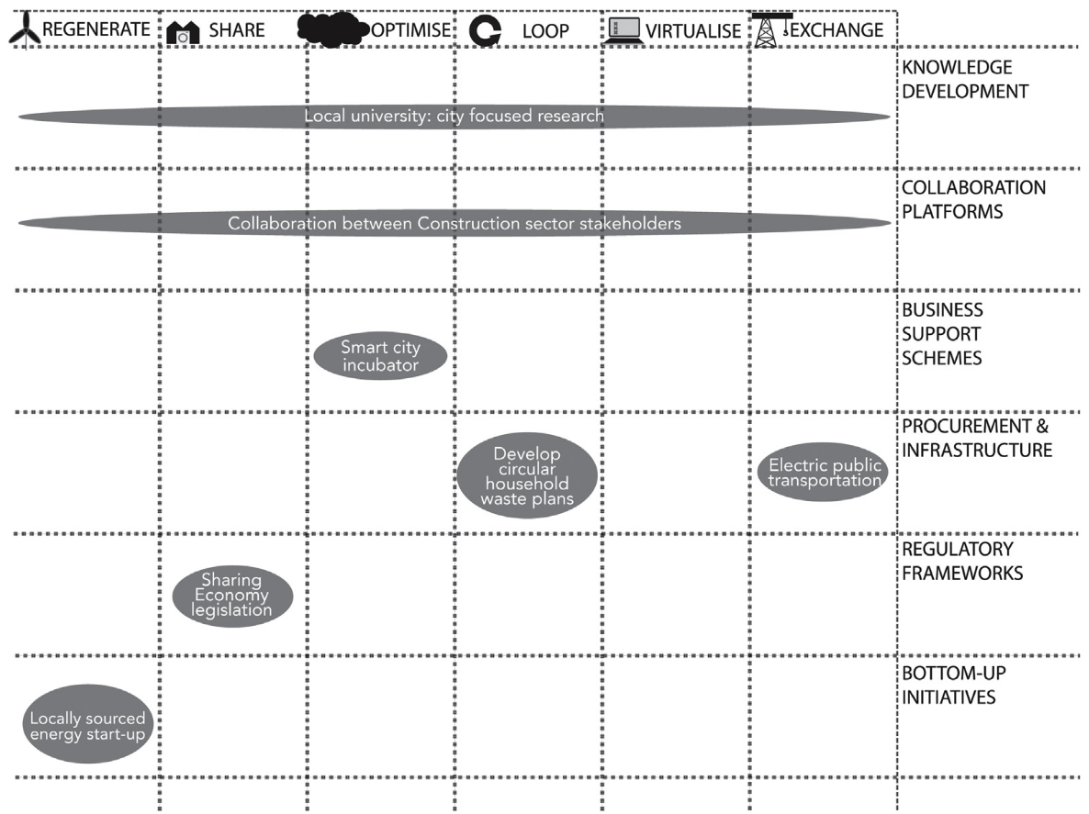
The full Governance Spectrum towards Circularity

Slide 53
An Example: The City of London

Slide 54
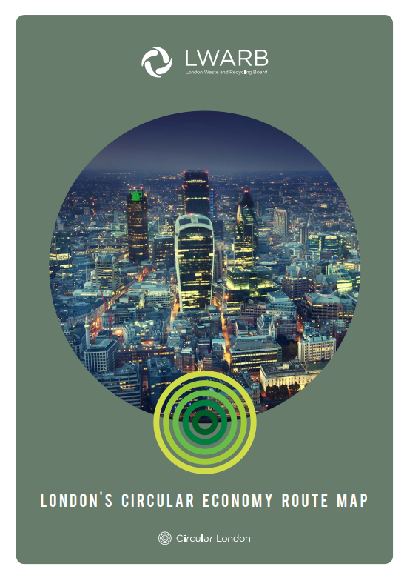
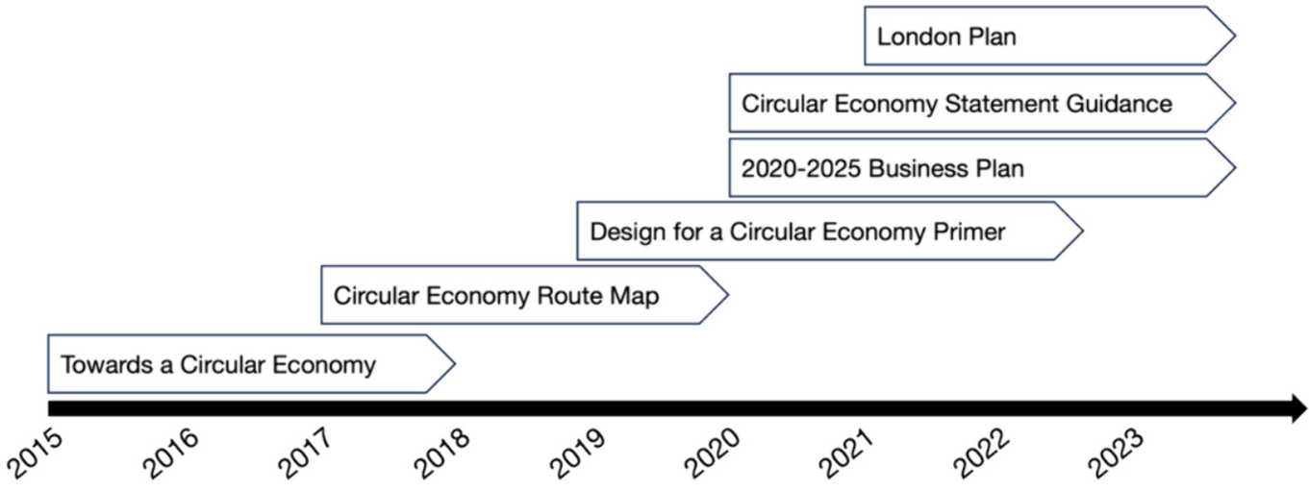
Why London?
Outside the Netherlands 😉
Long-lasting experience:
October 2024: Circular Economy Framework

Slide 55
The Status Quo: Key Stakeholders
Greater London Authority (GLA):
Develops city-wide policies and planning frameworks, including Circular Economy Statements for developments
ReLondon (formerly LWARB – London Waste and Resource Board):
Provides support and innovation for circular practices, focusing on sectors like textiles, plastics, and food
City of London Corporation:
Implements circular strategies within the Square Mile, including waste reduction and sustainable procurement
London Boroughs:
Responsible for local implementation and enforcement of circular economy principles
Private Sector and Businesses:
Adopts circular practices, driving innovation in areas like sustainable fashion, recycling, and green technologies
Non-Governmental Organisations (NGOs) and Academic Institutions:
Contribute research, advocacy, and educational programmes to support circular economy efforts.

Slide 56
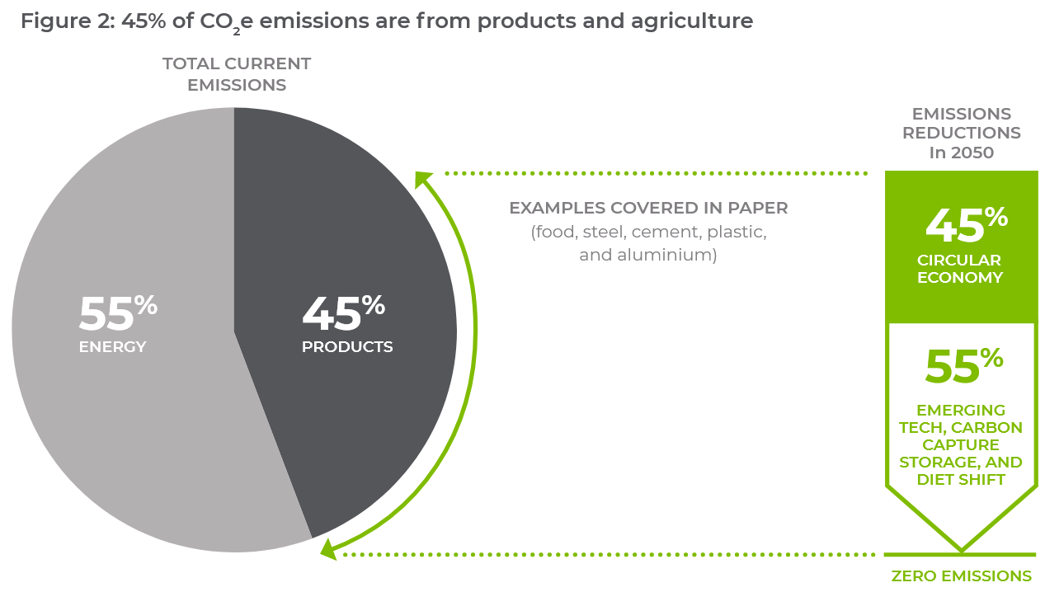
The Status Quo: Policy Goals of ReLondon (LWARB)
Notes:
London Waste and Resource Board

Slide 57
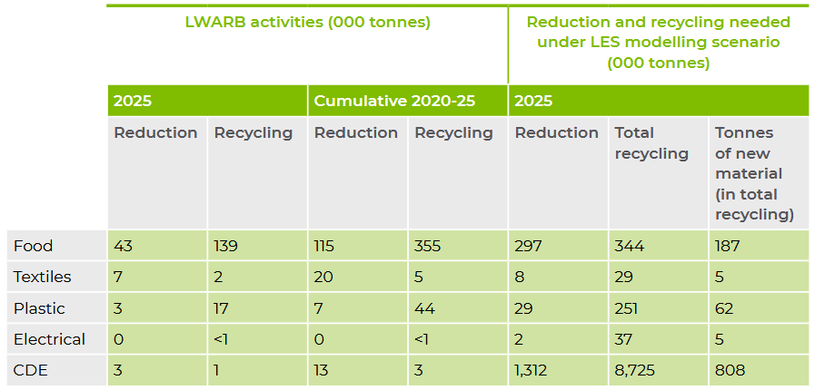
The Status Quo: Policy Goals of ReLondon (LWARB)
Notes:
LES = London Environment Strategy

Slide 58

The Status Quo: Budget of ReLondon (LWARB)
Notes:
LES = London Environment Strategy

Slide 59

Why London?

Slide 60

Why London?

Slide 61


A Closer Look: London’s Circular Economy Framework (2024)

Slide 62

A Closer Look: London’s Circular Economy Framework (2024)

Slide 63
An Important Distinction: The City of London Corporation & the “Square Mile”
Aspect | City of London Corporation | Square Mile
Definition | The municipal governing body responsible for administering the Square Mile. | A geographic area in central London, also known as the financial district or the City.
Role | Provides governance, services, and advocacy for the Square Mile and its residents, workers, and businesses. | The area where the City of London Corporation operates and exercises jurisdiction.
Scope | Extends influence beyond the Square Mile through stewardship of open spaces, cultural institutions, and global financial promotion. | Covers the historic heart of London, about 1.12 square miles in size.
Governance | Led by the Lord Mayor of the City of London and governed by the Court of Common Council. | Has no governance body of its own; it is governed entirely by the City of London Corporation.
Functions | Provides local government services (e.g., planning, waste management, policing) Promotes the City as a global financial hub Oversees cultural and historic sites. | Serves as the UK’s financial and professional services centre, housing institutions like the London Stock Exchange and Bank of England.

Slide 64

An Important Distinction: The “Square Mile” aka. City of London

Slide 65
An Important Distinction: Different Goals
1. The City Corporation:
Waste and Resources
Portfolio and Capital Projects
Supply Chain
Training, Communication and Engagement
2. The Square Mile:
Built Environment
Food and Beverage
Training, Communication and Engagement

Slide 66

The City of London Corporation Action Plan 2024-2027

Slide 67

The City of London Corporation Action Plan 2024-2027

Slide 68

The Square Mile Action Plan 2024-2027

Slide 69

The Square Mile Action Plan 2024-2027

Slide 70

The Timetable

Slide 71

Special: CE for Buildings in London

Slide 72


Special: CE for Buildings in London

Slide 73

Special: Assessment of Existing Buildings

Slide 74



Special: CE Statements as Policy Innovation

Slide 75

Impacts on the Supply Chain

Slide 76
Outlook

Slide 77
Wrap it up

Slide 78

An Outlook:

Slide 79


So long & cheerio!

